Slide 1
The Experiences of New Zealand Care Leavers who went to University
Slipping Down Ladders
And Climbing up Snakes
Dr Iain Matheson, New Zealand
Independent Researcher, and Massey University Adjunct Lecturer
EUSARF 2016, Oviedo, Spain

Slide 2
Disconnect between personal, professional, and organisational aspirations

Slide 3
Slipping Down Ladders
And Climbing up Snakes

Slide 4
Five key factors …

Slide 5
Aspirations

Slide 6
Aspirations
I’m going to have a baby and need to be able to provide for it. I can’t work in cafés for the rest of my life, and can’t provide a very good life for him without a proper education of some kind.

Slide 7
Talents and Passions

Slide 8
Talents and Passions
What I didn’t realise, was how good my uncle was and when I beat him, ’cause he was the only person I ever played in my life, and he must have been pretty good because I got to middle school and I was beating everyone left, right and centre even the teachers and everyone, I was only at middle school and the teachers were amazed. And then they entered me into a regional chess competition and I won that easily and so, I went to the nationals and got second ’cause I got beaten by New Zealand’s best. But I was pretty happy about it.

Slide 9
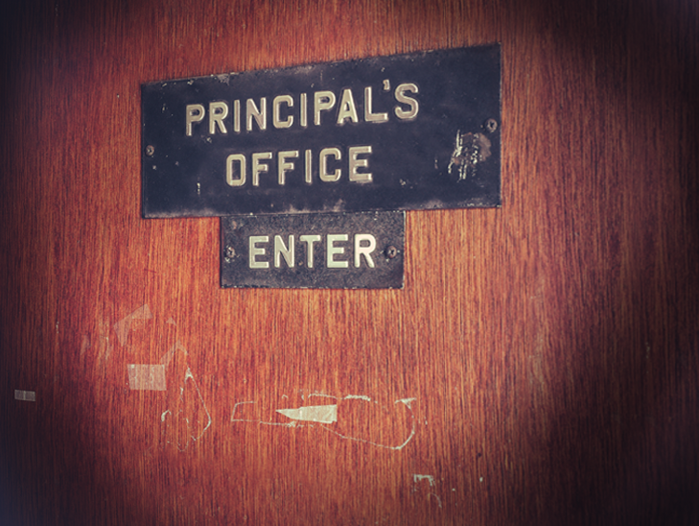
Managing Risks

Slide 10
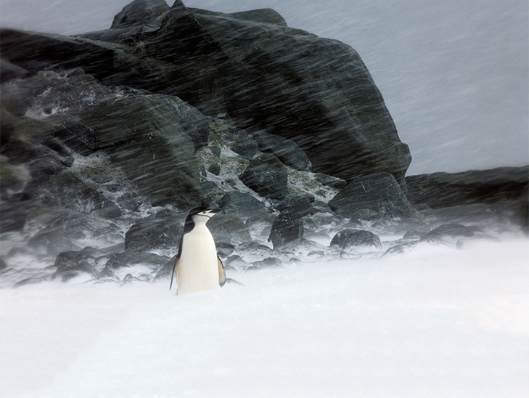
Resilience

Slide 11
Resilience
I actually just used to write my own notes. I do remember one of my form teachers ask me “did you write this for yourself?”
Well yeah, who else was going to write it? And he was like “Oh” and he never said anything more about it.

Slide 12
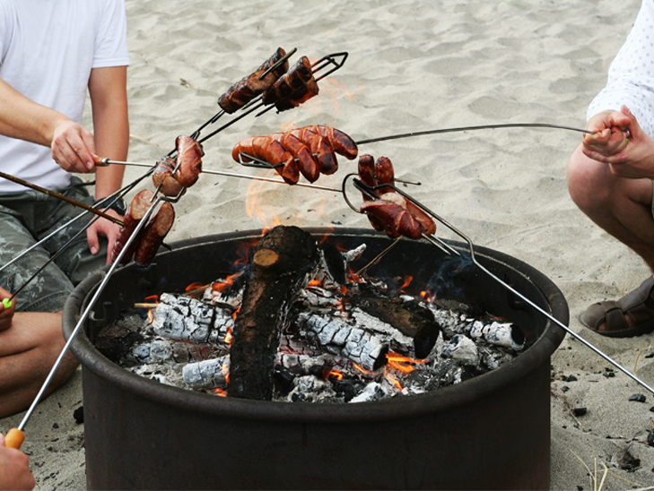
Connection

Slide 13
Aspirations
Talents and Passions
Managing Risks
Resilience
Connections

Slide 14
Gracias! Thank you!
For more information or a copy of the presentation and notes, please email me at: iain@mathesonassociates.co.nz
NOTE: For study participant privacy reasons, the presentation uses pseudonyms rather than any actual names. Similarly, while using their real words, the audio clips are voiced by others.
All images in this presentation are subject to copyright law and may not be used other than reproducing this presentation.

